Slide 1
Earth Art

Slide 2
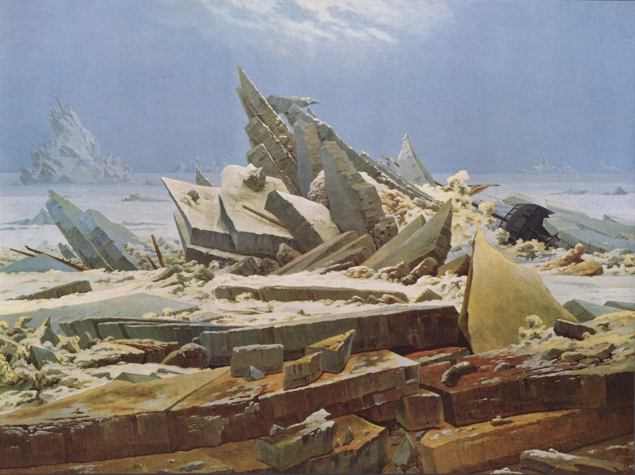

Notes:
Last slideshow started off with a painting by Caspar David Friedrich and so does this one. This time, we see a arctic shipwreck, the hull of a boat poking out of an iceberg, the mast shattered and scattered around. When the German romanticists were painting in the 19th century nature was seen as a vast and wild thing, capable of destroying humankind without provocation.
By the 1960s a new awareness began to emerge that the opposite was true too. Besides the sublime, the natural world began to reveal it was also fragile and could become a victim of humanity if we were not careful. It would be convenient to say earth artists were environmentalists and nowadays this is often true. For the first earth artists however, its a little more complicated than that, as they often saw nature as a raw material to be studied, manipulated, or used, not just as something to be saved.

Slide 3
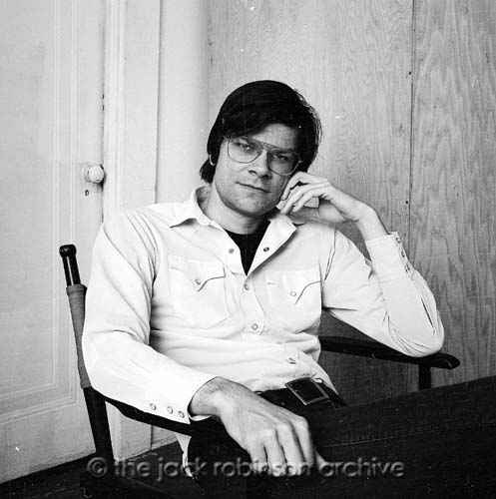
Robert Smithson
Notes:
Robert Smithson was one such artists interested in land as a medium.

Slide 4
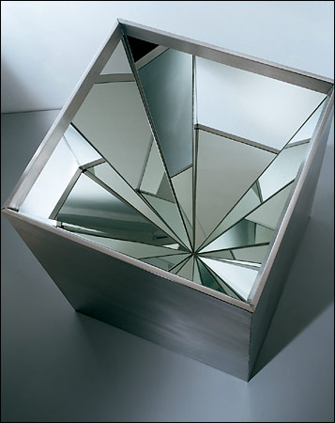
Notes:
His early minimalist pieces were often inspired by natural processes such as the formation of crystals on a molecular level.

Slide 5
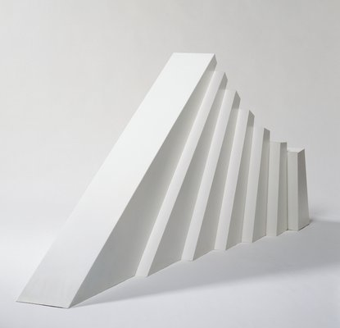
Notes:
Or larger scale structures such as the stratification of the earth’s crust.

Slide 6
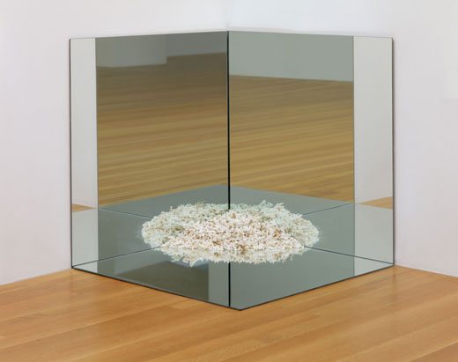
Notes:
He also used mirrors to create the illusion of larger spaces, as well as to refer to distant locations, such as the beach where he gathered this crushed coral.

Slide 7
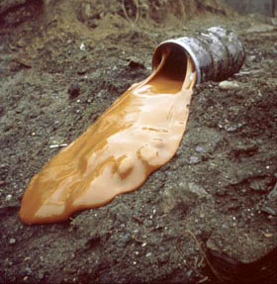
Notes:
He was fascinated with the interaction of earth and human industry, often working on lands already disturbed or polluted. Here is one of his pour pieces. In this one he poured a barrel of glue down a hill.

Slide 8
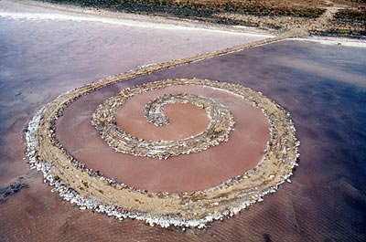
Notes:
His most famous piece, Spiral Jetty, rises out of the Great Salt Lake on a remote Northern shore. The shape reflects a salt crystal, which forms in a spiral, but the width of the jetty, large enough to support the dump truck which carried the gravel used to create the piece, reflects the much larger scale of the lake.

Slide 9
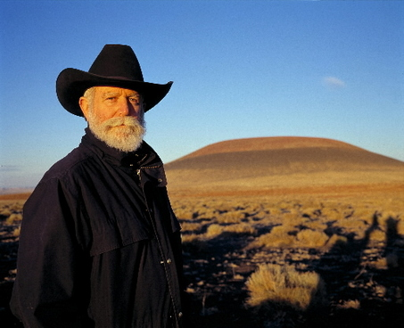
James Turrell
Notes:
James Turrell is another artist who brought artwork out of the gallery and into the outdoors. His primary obsession is the qualities of daylight.

Slide 10
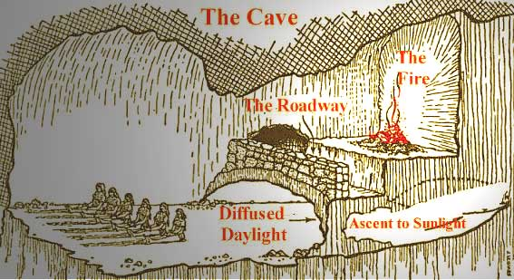
Notes:
His pieces often reflect his interest in Plato's cave, a philosophical metaphor introduced by the Greek philosopher in his dialogue "The Republic". The metaphor is as follows: Imagine a row of prisoners who have spent their entire lives chained in a cave, and only allowed to look at the back wall. Behind them, a series of events occurs, lit by a fire so that the shadows are cast upon the wall. Since this is the only thing they know, they take these shadows to be reality.
Now, imagine one of these prisoners escapes and makes his way out into the sunlight. At first it is too bright, he doesn't know what he sees. But gradually he begins to understand what the world is really like. In Plato's metaphor, this freed man represents the philosopher, who knows the world for what it really is. If he returns to the cave, and tells his friends what he has seen, they believe he has gone mad, for how could what he tells them be true.
For Turrell, this experience, of coming into the light and seeing things new is the experience he wishes to create for his audience.

Slide 11

Notes:
I am going to walk you through an indoor piece by Turell to give you a sense of how he achieves this. Here we are in a dark corridor in a museum, at the end of the hallway to the right is a door filled with a mysterious blue light.

Slide 12

Notes:
As you enter the room, all that you can make out at first is an intense blue light, and the silhouette of anyone standing in front of you. Gradually your eyes adjust. The corners of the room are curved. There are no lines to give you a sense of where you are.

Slide 13

Notes:
In fact, if there is no one in front of you, is it hard to tell if the room has any depth at all.

Slide 14
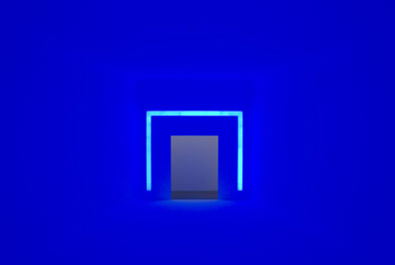
Notes:
As you turn around, the exit is clearly marked. As you exit the room you become the philosopher, looking at life again as if for the first time.

Slide 15
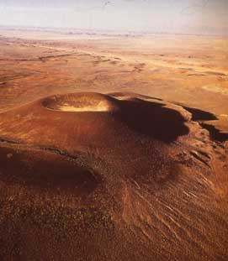
Notes:
When is comes to monumental artworks, this next one takes the cake. James Turrell bought the extinct Roden Crater outside of Phoenex Arizona in 1977. He began constructing this work in 1979 and continues to work on it to this day.

Slide 16
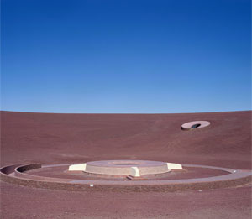
Notes:
The top of the crater acts as a natural dish, focusing the view away from the ground and up toward the sky. Inside of the crater, he has been constructing a series of rooms and tunnels with skylights to observe the motions of the solar system.

Slide 17
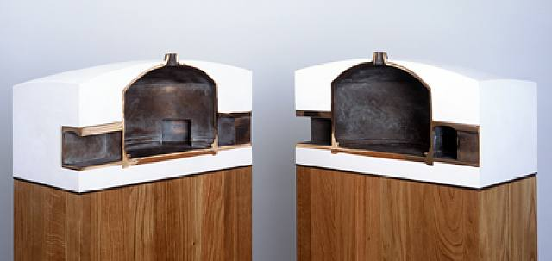
Notes:
Here is a model of one of the rooms to give you a sense of the immense vaulted ceilings.

Slide 18
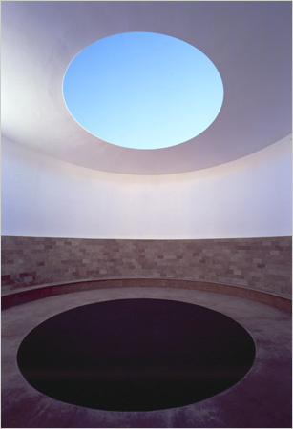
Notes:
Here is one of the rooms, a bench rings the rounded wall to allow a view of the skylight above. Just as Friedrich's Monk staring out into the sea reminds us of the sublime, here the viewer in Turrell's artwork can experience this feeling first hand.

Slide 19
Images:
Caspar David Friedrich
Sea of Ice, 1823-24
Robert Smithson (b. 1938 NJ—d. 1973 TX).
Four-Sided Vortex, 1965, stainless steel, 4 mirrors, 35 x 28 x 28
Leaning Strata, 1968, aluminum, paint, 49 x 105 x 30 inches
Corner Mirror with Coral. 1969. Mirrors and coral. 36 x 36 x 36"
Sandbox Monument, 1968, photograph
Glue Pour, 1969, Canada
Spiral Jetty, 1970, Salt Lake City, Utah
James Turrell (b.1943 CA)
(illustration, Plato’s Cave)
End Around, 2006
Roden’s Crater, 1977—present, AZ
Notes:
Caspar David Friedrich
Sea of Ice, 1823-24
Robert Smithson (b. 1938 NJ—d. 1973 TX).
Four-Sided Vortex, 1965, stainless steel, 4 mirrors, 35 x 28 x 28
Leaning Strata, 1968, aluminum, paint, 49 x 105 x 30 inches
Corner Mirror with Coral. 1969. Mirrors and coral. 36 x 36 x 36"
Sandbox Monument, 1968, photograph
Glue Pour, 1969, Canada
Spiral Jetty, 1970, Salt Lake City, Utah
James Turrell (b.1943 CA)
(illustration, Plato’s Cave)
End Around, 2006
Roden’s Crater, 1977—present, AZ

